Slide 1
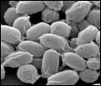
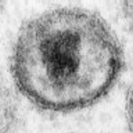
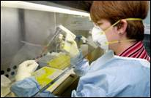
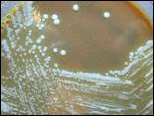
INFECTIOUS DISEASES

Slide 2
EXAMPLES OF TRANSMISSION
DIRECT CONTACT
INDIRECT CONTACT
VECTORS
AIRBORNE
CONTAMINATED FOOD AND WATER

Slide 3
Direct:
directly transferred from an infected person to another person
Examples:
  Contact with bodily fluids e.g.
  Blood, saliva, semen
  Disease: Herpes simplex virus 1 (cold sores), Human Immunodeficiency Virus (HIV)
Indirect:
transferred through a contaminated object or organism. Includes vectors, airborne transmission as well as contaminated food and water.
Notes:
Black out

Slide 4
Vectors:
?????????? example:????????????? disease:
Airborne: dispersed over long distances, face-to-face contact not required. example: sneezing, coughing disease:
Contaminated food and water: consuming a pathogen found in food and water example: improperly cooked chicken, water contaminated with fecal matter disease: food poisoning and cholera

Slide 5
INTERVENTION AND RESPONSE quarantine disrupting the pathogen life cycle improving water and food hygiene immunisation
Notes:
\

Slide 6
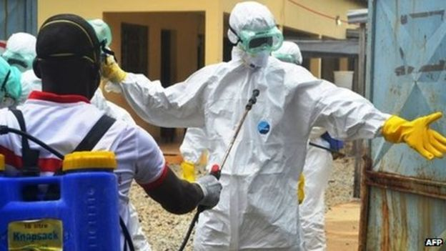

INTERVENTION AND RESPONSE :
QUARANTINE:
The use of isolation measures to contain the spread of disease. The separation and restriction of movement of persons who, have been exposed to a pathogen.

Slide 7
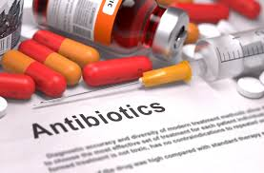
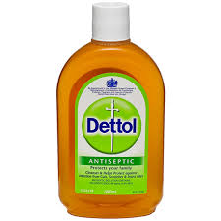
INTERVENTION AND RESPONSE :
DISRUPTION TO PATHOGEN LIFE CYCLE:
Antibiotics: kill and stop the reproduction of bacteria.
Antiseptics: kill OR stop growth and reproduction of microorganisms.
Antivirals: kill and stop the replication of a virus.
Antifungal: kill and stop the reproduction of fungi.

Slide 8
HYGIENE HYPOTHESIS
If the environment is "too clean," the hypothesis suggests that the immune system will not mature properly.
Later in life people may develop immune-related health problems such as asthma.

Slide 9
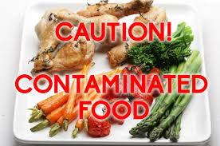
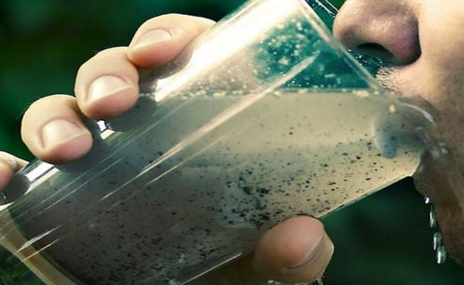
INTERVENTION AND RESPONSE
IMPROVED WATER AND FOOD HYGIENE:
Many countries have strict laws and regulations about the quality of water and food.

Slide 10


Slide 11
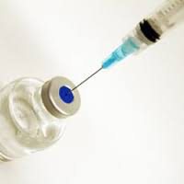
INTERVENTION AND RESPONSE
IMMUNISATION:
Injection of an imitation pathogen that does not cause the disease. Does allow the body to recognise the pathogen and fight the disease in the future.

Slide 12
BUILD A PATHOGEN
Name your pathogen
Pathogen type
Who are its hosts and how does it invade your host (transmission)?
What symptoms does it cause?
Previous outbreaks of your pathogen
when
where
how many people were infected
how many people died
treatments are there (vaccine or cure?)

Slide 13
Activity 1 | Activity 2
Aim: to test the effectiveness of different hand hygiene chemicals in destroying pathogens | Aim: to determine which areas of a school have the most/least pathogen growth
Method: Collect 8 agar plates, do not open them. Label the plates – no clean, alcohol swab, water, Dettol, dishwashing liquid, soap (bar) soap (liquid), hand gel. Place one finger in garden bed and remove after 5 seconds. Brush off any remaining soil. Push finger onto agar and seal plate with tape. This is the unclean plate. Put another finger into the soil and clean finger with a alcohol swab. Push finger onto agar and seal the plate. Repeat with remaining chemicals. | Method: Collect 8 agar plates, do not open them. Label each plate with 8 different locations around the school. Collect 8 cotton tips Swab area using cotton tip and then swipe cotton tip over agar. Seal plates with tape upon return.

Slide 14
The process of immunisation
1. A killed or inactive version of the disease is introduced into the body via a vaccine.
2. The immune system: white blood cells called lymphocytes make antibodies against the inactive disease
3. The lymphocytes make memory cells that ‘remember’ the disease
4. The antibodies then stay in our bloodstream in case we encounter the real thing
5. The memory cells recognise the disease again so we make more antibodies quicker next time

Slide 15

Robin Cochran-Dirksen (Many slides from BioEdOnline Baylor Christine Herrmann PhD)

Slide 16
ETHICS
Much has been written about vaccine refusal and its implications for public health, both internationally and within Australia.
In March 2019, the national coverage rates were:
94.14% for all one year olds
91.15% for all two year olds
94.78% for all five year olds
Parents who do not get their children immunised no longer receive Family Tax Benefit part A – no longer receive the $728 end of financial year supplement.
Tonight: Conduct research into both sides of the argument
FOR AND AGAINST
5 points = FOR and 5 points = AGAINST

